Slide 1

Marketing & Outreach!

Slide 2
Today’s Lesson!
3m - Ice Breaker
3m - What is Marketing?
What does Marketing do?
How does Marketing help the team?
2m - Brief graphic design
2m - Promotions, newsletters, merch, etc.
15m - Building a website
35m - Workshop time: Building your own site to feature your project.

Slide 3
Ice Breaker
Think of your favorite brand...
Ex. Technology (Apple), Clothing/Apparel (Nike), Social Media (Snapchat)
How does that brand advertise or market their product? → everyone

Slide 4
Intro to Marketing
What is marketing?
Makes the “brand” known
Marketing works through many avenues
Advertising (ex. Televisions advertisements)
Promotions (ex. sales/deals)
Partnerships (ex. donations/organizations)
Logos (ex. Apple symbol, Nike “swoosh”)
How does Flight Club Aerospace market?
Websites
Blog posts and newsletters
Graphic design (logos, merch, videos, etc.)

Slide 5
Partnerships
Sponsor and grant applications
Connecting with industry experts
Partnering with organizations
Do your research!
Contact specific people who will get the job done
Make sure that the organizations have the same interests
Outreach focuses on making the organization into a business

Slide 6





Graphic Design
It’s extremely important for things to look good! Logos are especially important.
What’s important in a logo?
A color scheme: colors reflect messages. Is your brand colorful or black and white? Dark or light? Cool or warm?
It’s on topic: only include what will accurately represent your brand. Would someone be able to tell what your brand does just from the logo?
It’s unique: be creative! If your logo is like others you have seen before, it will not be as memorable.
Photoshop or equivalents, photography & videography

Slide 7
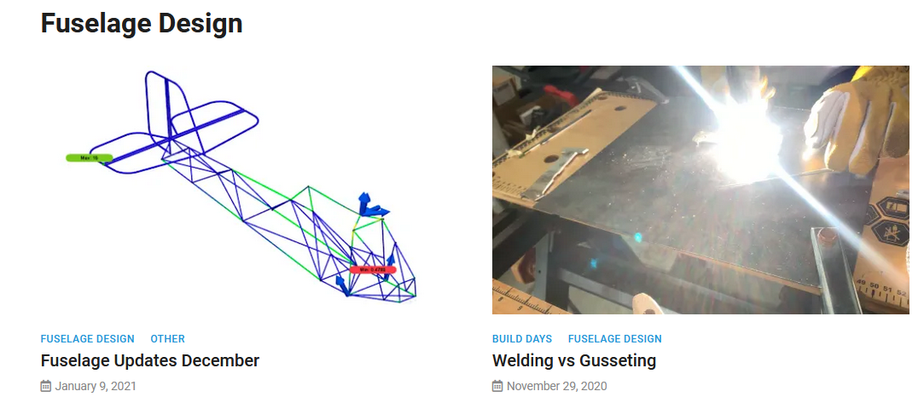
Documentation
Newsletters, blogs, information hubs, etc.
Why is this important?
Keeps investors and donors up to date on the project as it happens.
Gives insight into the inner workings of the process.
May pique interest of potential new members or other people working on similar projects.

Slide 8




Merch
Great way to get your group recognized and get support from others!
Requires an ecommerce platform, payment gateways, and shipping.
Not great to start out with, can be a huge money pit.
Cuts into donations since it costs money to buy merch, however, many people are willing to buy merch rather than just donating
How?
Printing companies! CustomInk, UGP, etc.
~$12 for t-shirts, ~$30 for hoodies, ~$20 hats

Slide 9
Building a website!
Brief explanation & tutorial, then you get to build your own!
Domain → Hosting → Website
Websites can be built on many different platforms. FCA uses WordPress, but it’s not super user-friendly. Some are paid, some are free.
WordPress, Squarespace, Wix, Weebly, Google Sites, etc.
For this project, we’re going to be using Google Sites (it’s free and easy to learn, self-hosted) *will require you to have a google account!
(10m) Google Sites tutorial!
Notes:
Changing page names, how to upload an image, how to delete/add sections, how to write, add pages, how to add text, format text, how to publish site, how to view the site, changing themes,

Slide 10
Workshop Time → in breakout rooms
Take photos or screenshots of your finished project, build an explanation, and build your site!
Feel free to ask if you have any questions or need help with something!
Make you site appealing and interactive, we will present these later.
(40m) Google Sites workshop time

Slide 11
Website Requirements
Home Page: Name, grade, school, year
Physics Page: Make a diagram (zoom white board screenshots, ms paint, powerpoint/slides, jamboard) of a science concept you learned this camp
Ex. forces on a plane, how does a wing produce lift?, control systems, parts of a plane, etc.
CAD Page: Screenshots of your Wing CAD & Fuselage CAD
Explain what sketching is, what features you used (extrude, linear pattern, etc)
Electrical Page: Picture(s) of a snap circuit and explain the physics
*Once you’ve completed your website, please put the URL in the Zoom chat. We’re not going to present these today, but we will post all websites to pace.comwww.flightclubaeros/summercamp/ for others to see!

Slide 12
Ending Activity
Time for all of you to market!
Think of a product that you want to market. This product does not have to be real/possible, but should be marketable (have a purpose). Go ahead and make a quick marketing speech for the product. Explain how you will market the product using the concepts that you learned throughout this presentation (advertisements, partnership deals, blogs, etc.). At the beginning of your speech you will briefly explain what the product is and why it is beneficial, and show the logo that you made.

